Slide 1

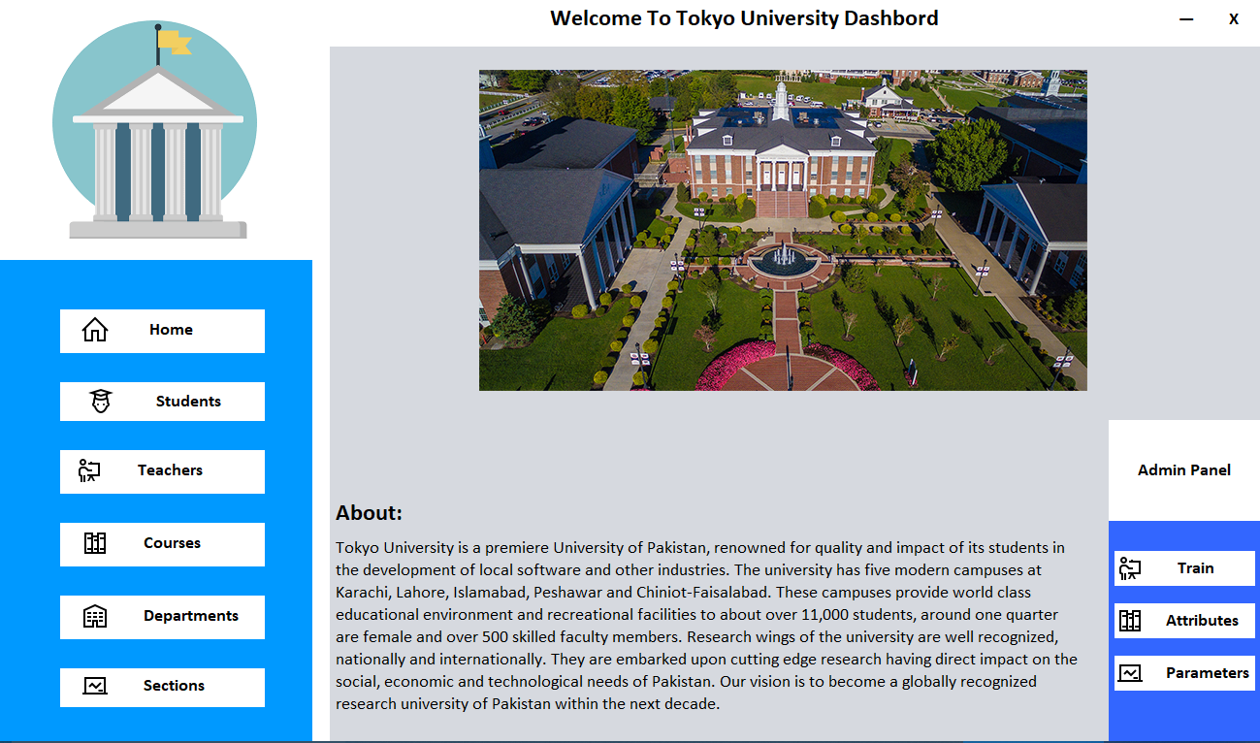
Student Advisory System

Slide 2
GROUP MEMBERS
Muaaz Anwar 16k-3628
Ubaid Ul Haq 16k-3631
Syed Hassaan Saleem 16k-3633
Ali bin Arshad 16k-3637
Section: A

Slide 3
Project Definition
Student face many problems during registration of courses i.e. what course to register and which elective to take in order to maintain GPA. So in this project we have implemented Student Advisory System that guide student during time of registration.
This project mainly emphasize registration of courses by giving suggestion to student considering previous performance of student. It also provide platform to student for communication with teacher by using chat box. It also divide students into different section according to their background and mentality.

Slide 4
Project Scope
This project uses Machine Learning Algorithm
To give advice to student in the Registration of Courses.
Shows predicted GPA of student.
Use different attributes to divide students into different sections.
This project also provide chatbox for communication but it is implemented in localhost server which restrict to access data from other system.

Slide 5
Problem Statement
“To implement system that provide platform to Tokyo University and student so they can register their semester courses online. Student must also able to get help from either system (AI) or from teacher (Using chat box). System advise student according to their previous performance of student and can also predict GPA of currently registered courses”

Slide 6
Functional & non-Functional Requirements

Slide 7
Shows Student and Teacher Information.
Shows available courses for Registration and also gives Recommendation.
Provides Chat Box for Communication.
Automatically assign Section to newly Registered student (GPA Prediction).
Shows Searched data within seconds.
Uses fully Normalized schema.
Interface for Modification of ML parameters provided.

Slide 8
Use Case Diagram

Slide 9
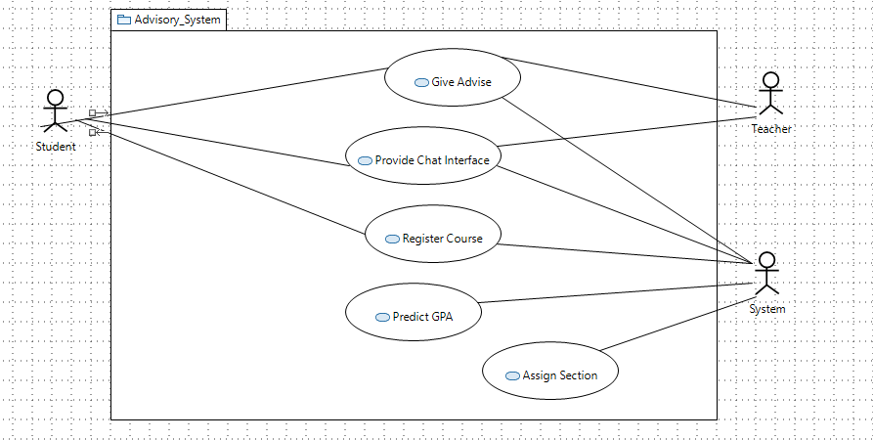
1

Slide 10
Class Diagram

Slide 11
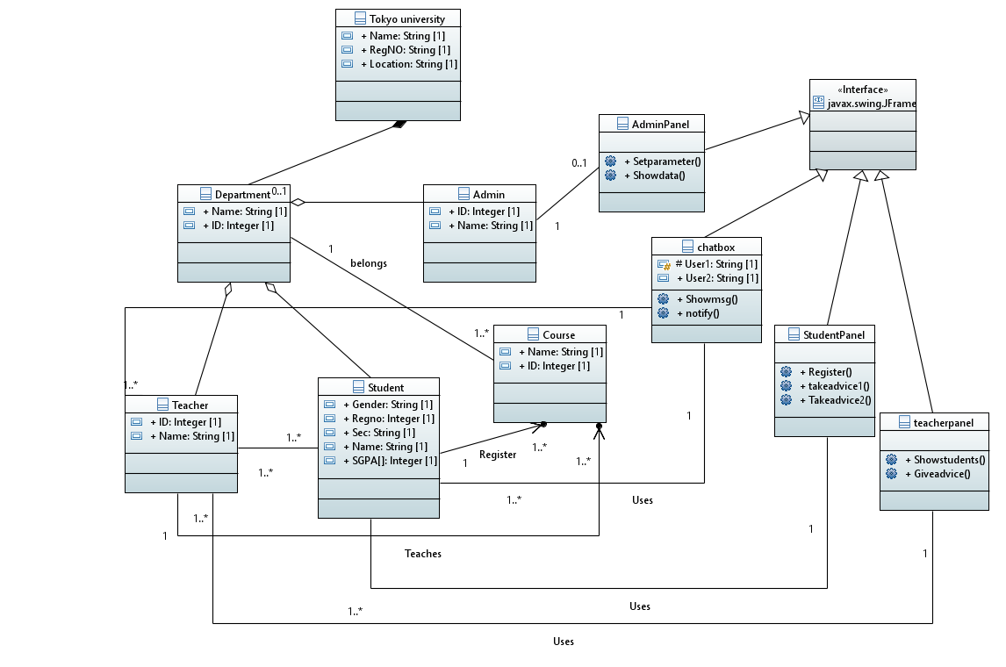

Slide 12
Activity Diagram

Slide 13
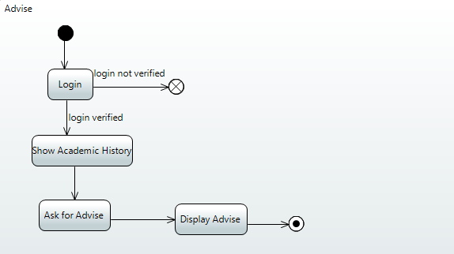
Advise

Slide 14
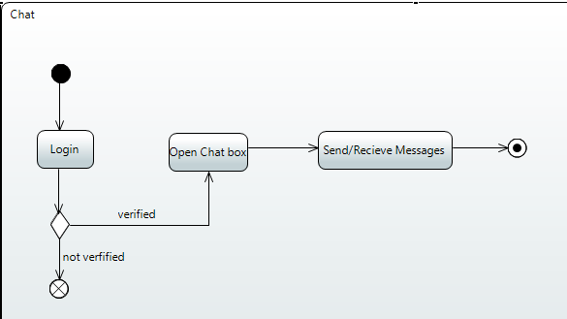
Chat

Slide 15
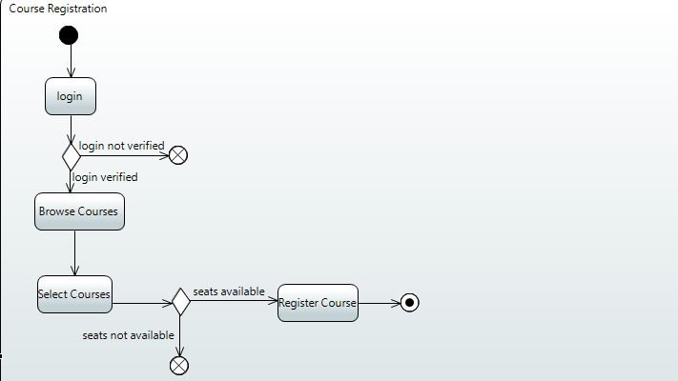
Course Registration

Slide 16
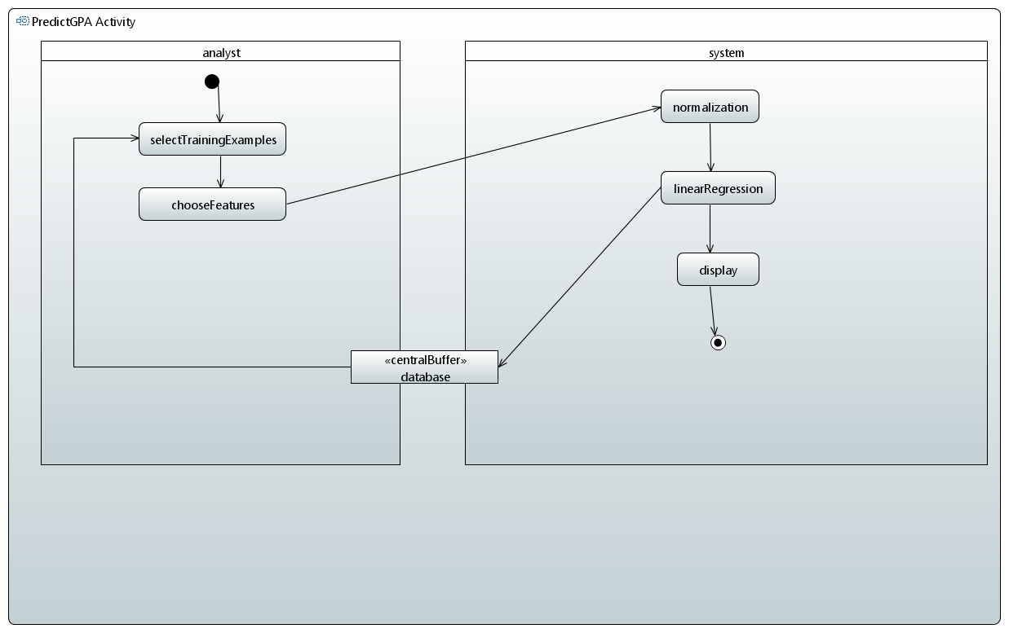
Predict GPA

Slide 17
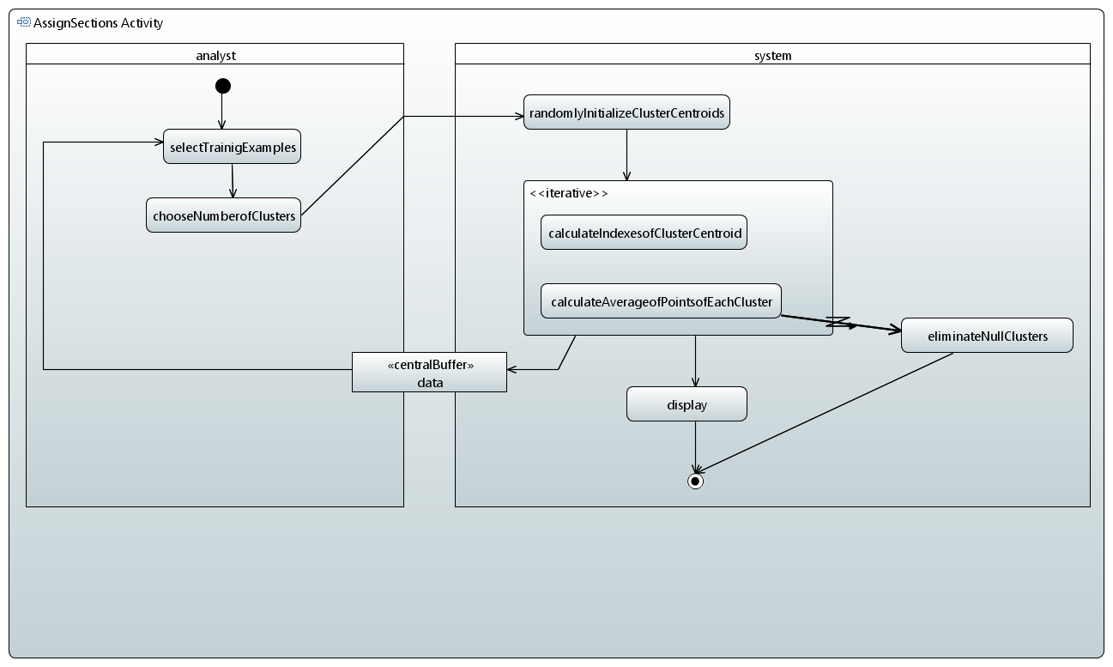
Assign Section

Slide 18
Interaction Diagram

Slide 19
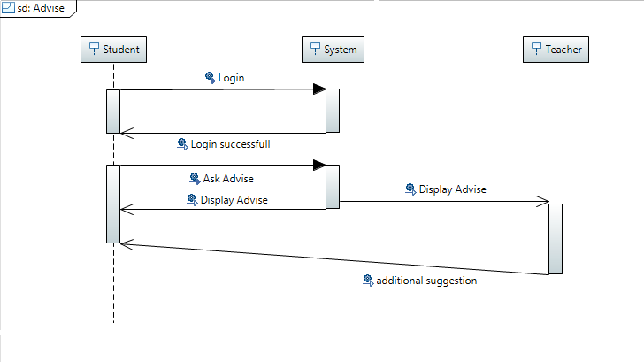
Advise

Slide 20
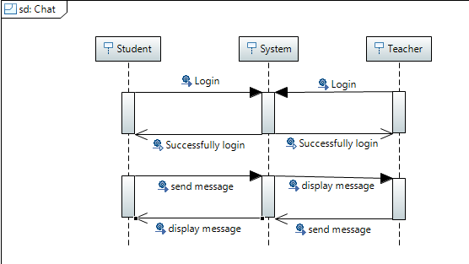
Chat

Slide 21
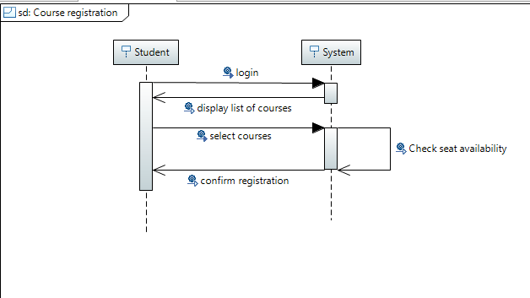
Course Registration

Slide 22
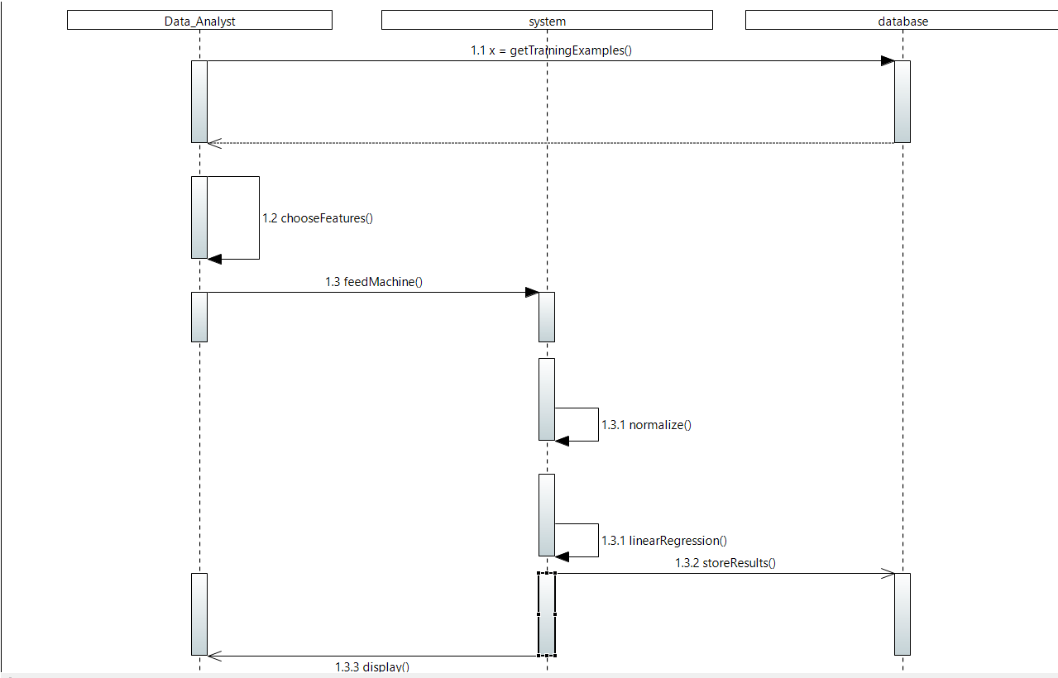
Predict GPA

Slide 23
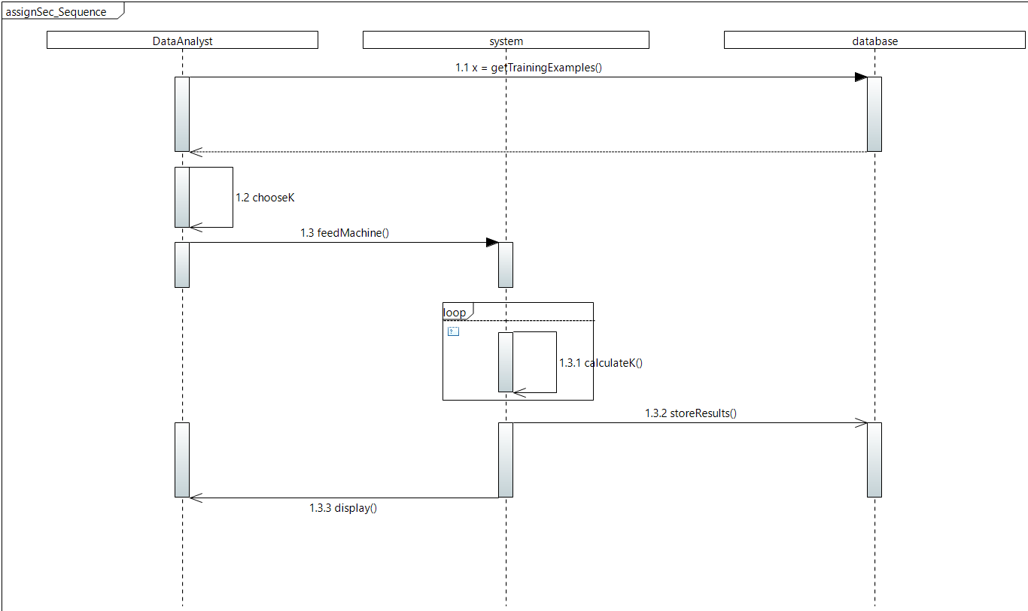
Assign Section

Slide 24
Implementation Diagram

Slide 25
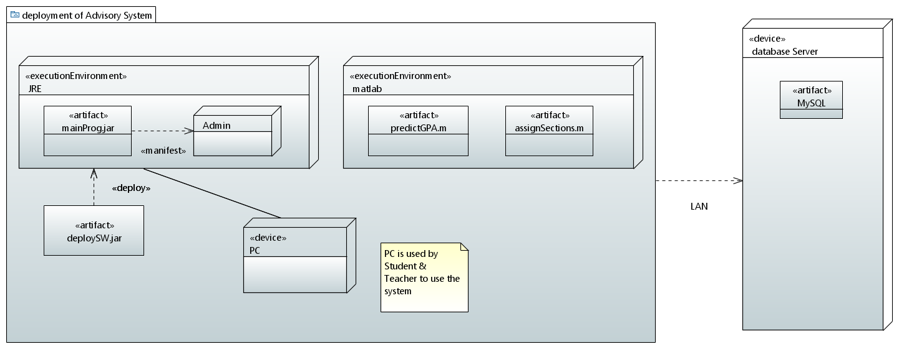
Deployment Diagram

Slide 26
State Chart Diagram

Slide 27
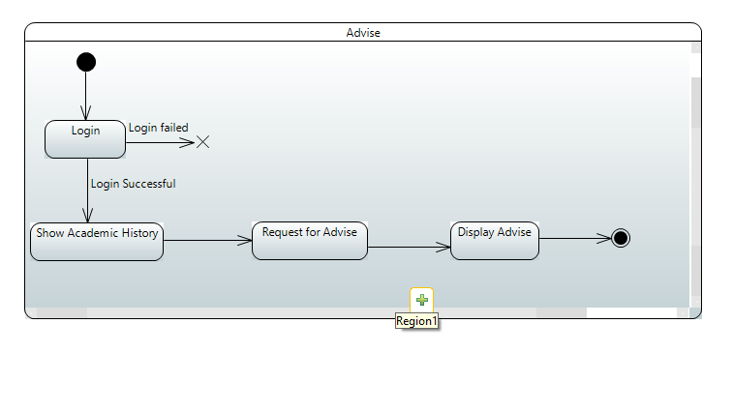
Advise

Slide 28
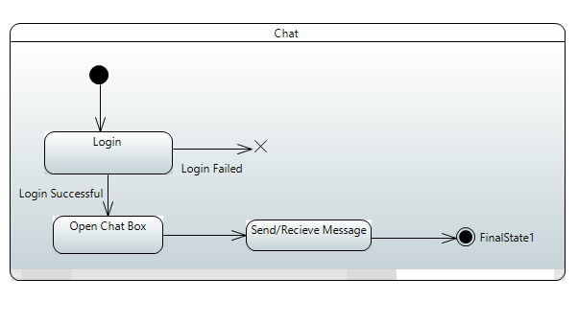
Chat

Slide 29
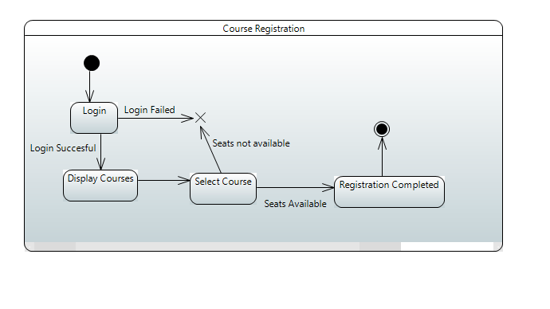
Course Registration

Slide 30
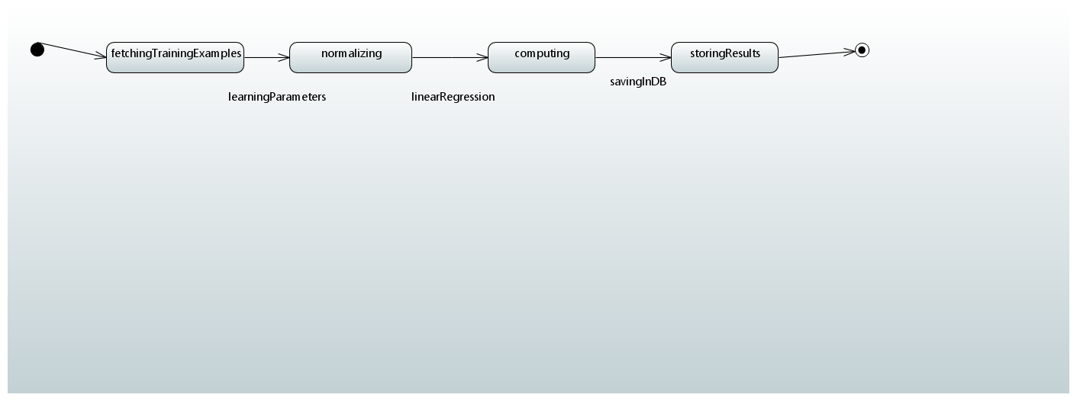
Predict GPA

Slide 31
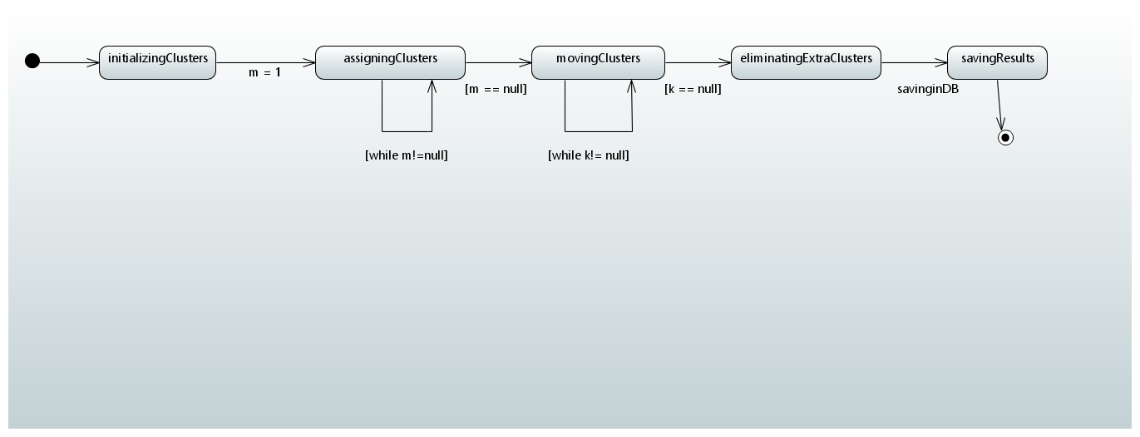
Assign Section

Slide 32
Questions?

Slide 33
THANK YOU

